Slide 1
Predicting Used Houses Prices
Submitted by-:
Manoj Kumar Saxena

Slide 2
Content
Problem Description
Data pre-processing
EDA
Data cleaning
Model Deployment
Hyper Parameter Tuning
Conclusion

Slide 3
Problem Description & Understanding of Data

Slide 4
Problem Description
Houses are one of the necessary need of each and every person around the globe and therefore housing and real estate market is one of the markets which is one of the major contributors in the world’s economy. Data science comes as a very important tool to solve problems in the domain to help the companies increase their overall revenue, profits, improving their marketing strategies and focusing on changing trends in house sales and purchases. Our problem is related to one such housing company.
A US-based housing company named Surprise Housing has decided to enter the Australian market. The company uses data analytics to purchase houses at a price below their actual values and flip them at a higher price. For the same purpose, the company has collected a data set from the sale of houses in Australia. The data is provided in the CSV file below. The company is looking at prospective properties to buy houses to enter the market. We are required to build a model using Machine Learning in order to predict the actual value of the prospective properties and decide whether to invest in them or not.

Slide 5
Column Description
MSSubClass: Identifies the type of dwelling involved in the sale such as:
20 1-STORY 1946 & NEWER ALL STYLES
30 1-STORY 1945 & OLDER
40 1-STORY W/FINISHED ATTIC ALL AGES
45 1-1/2 STORY - UNFINISHED ALL AGES
50 1-1/2 STORY FINISHED ALL AGES
60 2-STORY 1946 & NEWER
70 2-STORY 1945 & OLDER
75 2-1/2 STORY ALL AGES
80 SPLIT OR MULTI-LEVEL
85 SPLIT FOYER
90 DUPLEX - ALL STYLES AND AGES
120 1-STORY PUD (Planned Unit Development) - 1946 & NEWER
150 1-1/2 STORY PUD - ALL AGES
160 2-STORY PUD - 1946 & NEWER
180 PUD - MULTILEVEL - INCL SPLIT LEV/FOYER
190 2 FAMILY CONVERSION - ALL STYLES AND AGES

Slide 6
MSZoning: Identifies the general zoning classification of the sale.
A Agriculture
C Commercial
FV Floating Village Residential
I Industrial
RH Residential High Density
RL Residential Low Density
RP Residential Low Density Park
RM Residential Medium Density
LotFrontage: Linear feet of street connected to property
LotArea: Lot size in square feet
Street: Type of road access to property
Grvl Gravel
Pave Paved

Slide 7
Alley: Type of alley access to property
LotShape: General shape of property
LandContour: Flatness of the property
Utilities: Type of utilities available
LotConfig: Lot configuration
Neighborhood: Physical locations within Ames city limits
Condition1: Proximity to various conditions
Condition2: Proximity to various conditions (if more than one is present)
BldgType: Type of dwelling
HouseStyle: Style of dwelling
OverallQual: Rates the overall material and finish of the house
OverallCond: Rates the overall condition of the house
YearBuilt: Original construction date
YearRemodAdd: Remodel date (same as construction date if no remodeling or additions)
RoofStyle: Type of roof
RoofMatl: Roof material

Slide 8
Exterior1st: Exterior covering on house
Exterior2nd: Exterior covering on house (if more than one material)
MasVnrType: Masonry veneer type
MasVnrArea: Masonry veneer area in square feet
ExterQual: Evaluates the quality of the material on the exterior
ExterCond: Evaluates the present condition of the material on the exterior
Foundation: Type of foundation
BsmtQual: Evaluates the height of the basement
BsmtCond: Evaluates the general condition of the basement
BsmtExposure: Refers to walkout or garden level walls
BsmtFinType1: Rating of basement finished area
BsmtFinSF1: Type 1 finished square feet
BsmtFinType2: Rating of basement finished area (if multiple types)
BsmtFinSF2: Type 2 finished square feet

Slide 9
BsmtUnfSF: Unfinished square feet of basement area
TotalBsmtSF: Total square feet of basement area
Heating: Type of heating
HeatingQC: Heating quality and condition
CentralAir: Central air conditioning
Electrical: Electrical system
1stFlrSF: First Floor square feet
2ndFlrSF: Second floor square feet
LowQualFinSF: Low quality finished square feet (all floors)
GrLivArea: Above grade (ground) living area square feet
BsmtFullBath: Basement full bathrooms
BsmtHalfBath: Basement half bathrooms
FullBath: Full bathrooms above grade
HalfBath: Half baths above grade
Bedroom: Bedrooms above grade (does NOT include basement bedrooms)
Kitchen: Kitchens above grade
KitchenQual: Kitchen quality

Slide 10
TotRmsAbvGrd: Total rooms above grade (does not include bathrooms)
Functional: Home functionality (Assume typical unless deductions are warranted)
Fireplaces: Number of fireplaces
FireplaceQu: Fireplace quality
GarageType: Garage location
GarageYrBlt: Year garage was built
GarageFinish: Interior finish of the garage
GarageCars: Size of garage in car capacity
GarageArea: Size of garage in square feet
GarageQual: Garage quality
GarageCond: Garage condition
PavedDrive: Paved driveway
Fence: Fence quality

Slide 11
WoodDeckSF: Wood deck area in square feet
OpenPorchSF: Open porch area in square feet
EnclosedPorch: Enclosed porch area in square feet
3SsnPorch: Three season porch area in square feet
ScreenPorch: Screen porch area in square feet
PoolArea: Pool area in square feet
PoolQC: Pool quality
MiscFeature: Miscellaneous feature not covered in other categories
MiscVal: $Value of miscellaneous feature
MoSold: Month Sold (MM)
YrSold: Year Sold (YYYY)
SaleType: Type of sale
SaleCondition: Condition of sale

Slide 12
Data Summary
float64(3), int64(35), object(43)
float64(3), int64(35), object(43)
Data has null values for most of the features for both train & test dataset.
Data has 1168 no. of records for the training dataset and 292 no. of records for test dataset.
There were 43 object type variables, 34 integer type variable, 3 float type features and the target variable is of integer type.
Removed Id features consisting unique values and Utilities for the houses are same.
Converted the target variable i.e. SalePrice in lacs.

Slide 13
Alley, MasVnrType, MasVnrArea, BsmtQual, BsmtCond,
BsmtExposure, BsmtFinType1, BsmtFinType2 FireplaceQu, GarageType, GarageFinish, GarageQual, GarageCond, PoolQC, Fence, MiscFeature.
These were the features for both the dataset that has null values in it.
This may be because Such type of qualities of the features was no available.
So, I replaced such features of null values consistent by not available.
GarageYrBlt: As this is because of no Garage in the house so there were null values. So, replaced by 1800 because so, that there should be not much variance in the feature.
LotFrontage: This features should be float type it it was showing object because of some missed values that were consisting method in it. So, later on I replaced it by mean values.

Slide 14
Exploratory Data Analysis (EDA)

Slide 15
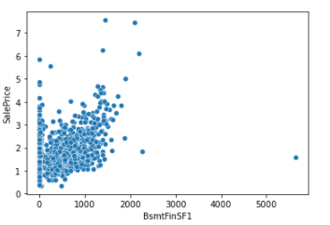
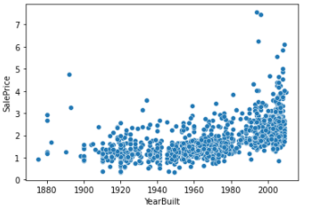
from above graph we know that there is some linear relation between Basement Type 1 finished in sq. ft. and Sale Price of the Houses.
from above graph we know that there is some linear relation between House built and Sale Price of the Houses.

Slide 16
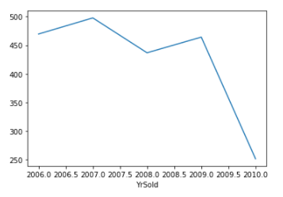
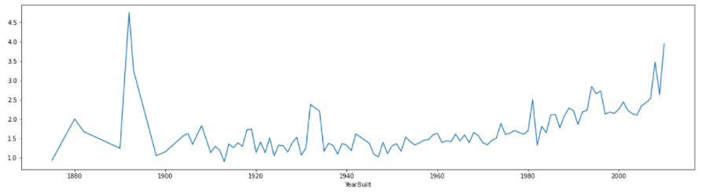
There is extreme loss is sale price of house in between year 2009 and 2010.
Here we analyses that the more the house was built new has their total sales price increasing from 1898.

Slide 17
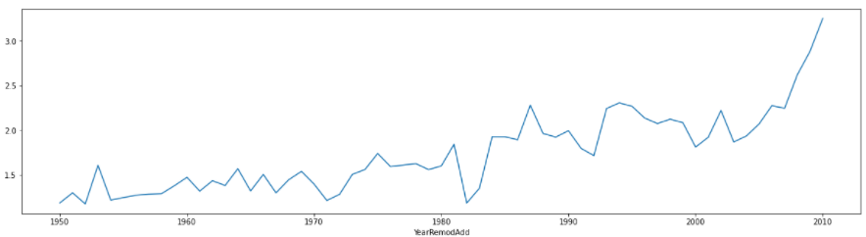
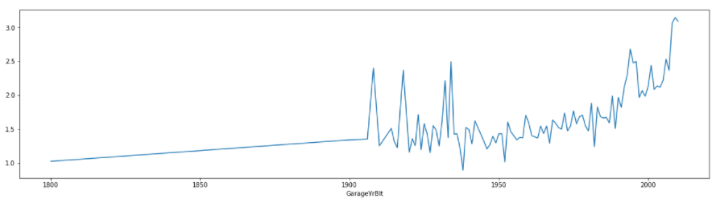
Here we analyses that the more the house that were remodeled with increase in the years the average sales price of the houses were increased.
The older the garage the lower the prices for the houses.

Slide 18
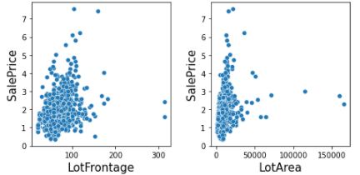
LotFrontage: Linear feet of street connected to property is somehow seems that there is some linear relation between them.
LotArea: Not so specific but the lot area somehow seems like to be very slight increase in the area leads to extra amount of change in increasing manner of SalesPrice.

Slide 19
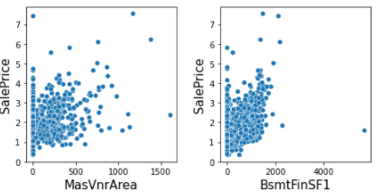
MasVnArea: Masonry veneer area except zero area there is linear relations that tells that increase in the masonry areas lead to increase the sales Price of the houses.
BsmtFinSF1: Basement finished Type 1 rather than zero square feet there is some min amount of increase in the area there is good amount of increase in Sale Price of House.

Slide 20
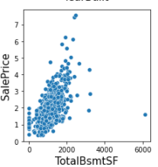
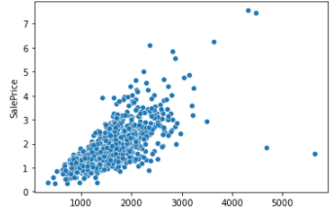
Shows that there is increase in the total areas for the basement in the house leads to increase in the Sale Price.
1stFlrSF,2ndFlrSF these two features after adding means total area of both 1st and 2nd floor combinedly showing the linear relations w.r.t. Sale Price of the houses.

Slide 21
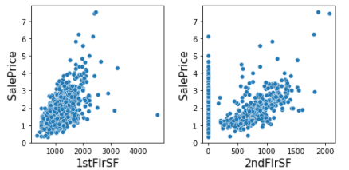
1stFlrSF: In this more area in on the 1st Floor of houses will impact to increase in the sale price of the houses.
2ndFlrSF: In this more area in on the 2nd Floor of houses will impact to increase in the sale price of the houses.

Slide 22
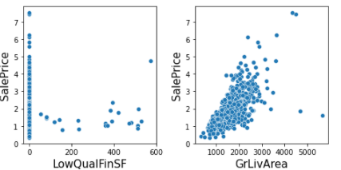
LowQualFinSF: Not much impacts it showing to the target variable but consisting 0 sq. ft. area for most no. of houses this may be because of there were no such houses that had done low quality finishing in their houses.
GrLivArea: In this more increase in above grade (ground) living area will impact to increase in the sale price of the houses.

Slide 23
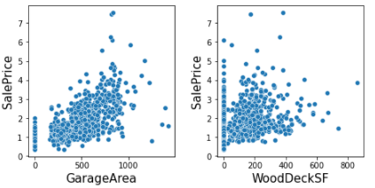
GarageArea: Except with the 0 area there is some linear relation that stats that increase in the Garage area increase the Sale price of the House.
WoodDeckSF: Except with the 0 area sq. ft. there is some linear relation that stats that increase in the Wood Deck area increase the Sale price of the House. And seems to be outliers in it.

Slide 24
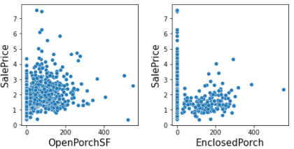
OpenPorchSF: Except with the 0 area sq. ft. there is some linear relation that stats that increase in the open Porch area increase the Sale price of the House. And seems to be outliers in it.
Enclosed Porch, 3SnPorch,ScreenPorch, Pool Area, MiscVal these area very less founded in the houses due to which not much info we gathered from graph.

Slide 25
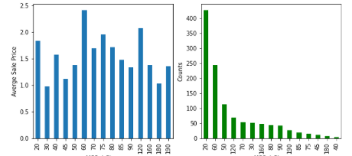
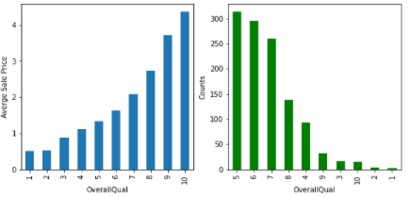
MSSubClass: 20 type(1-STORY 1946 & NEWER ALL STYLES) of dwelling involved in the sale are the most that were sold while 60 type (2-STORY 1946 & NEWER) of dwelling involved in the sale that are highly expensive that were sold.
OverallQual: As in data description there we set a no. from 1 to 10 that specifies the quality so in accordance with that higher the quality higher the price for sale. And there are very less no. for records for quality of houses 1 7 2 that are very poor/ poor. $$

Slide 26
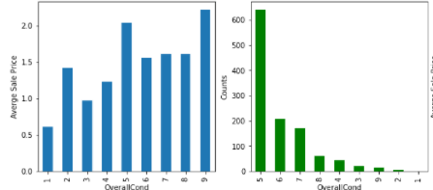
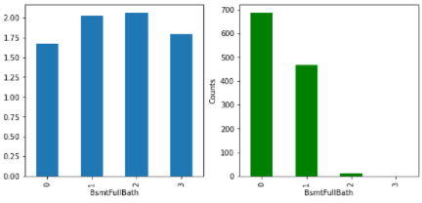
OverallCond: Here I analyze that the average overall condition of houses i.e. 5 were more in sale from both graph as better the conditions of houses their prices for sale in increasing. $$
BsmFullBath: there are zero no. of full basement bathroom records are high from both for these graph I analyzed that more the no. of basement Full bathrooms more the sales price for the house. $$

Slide 27
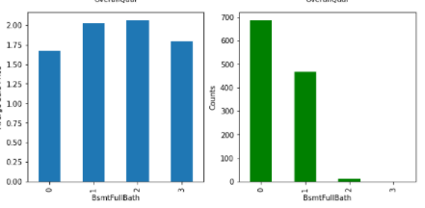
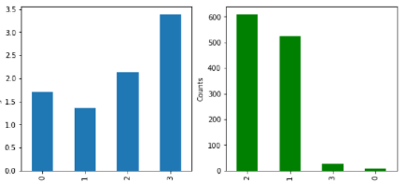
BsmFullBath: there are zero no. of full basement bathroom records are high from both for these graph I analyzed that more the no. of basement Full bathrooms more the sales price for the house. $$
FullBath: Increased in the no. of full bathrooms will result in the increase in sale price for the houses and there are very less records for the O & 3 no. of bathrooms.

Slide 28
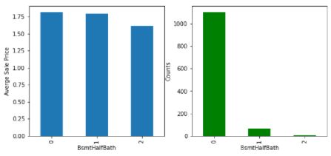
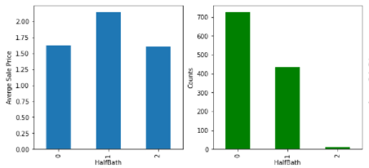
BsmtHalfBath: from both graphs there is only analyze that there are more no. of houses that has no half bathroom in basement. $$
HalfBath: there are very no. of houses that has 2 no. of Half bathrooms but the average sale price for having only 1 half bathroom is maximum.

Slide 29
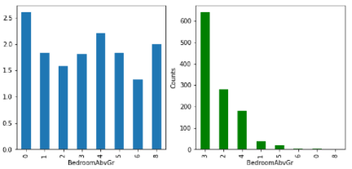
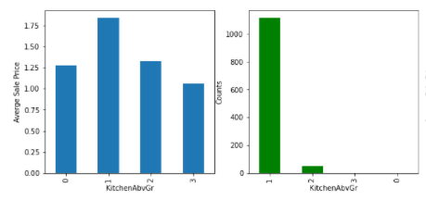
BedrooomAbvGr: there no such impacts for the no. of bedrooms to the sale Price but there very less no of records for 6,0,8 no. of bedrooms that lead model to underfitted.
KitchenAbvGr: very less records for the houses having 3 or no kitchen above ground and the sale price are high for having only 1 kitchen in the house.

Slide 30
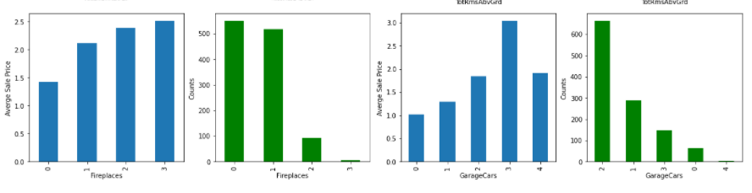
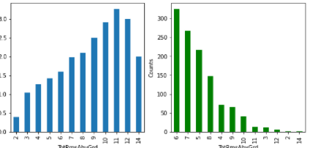
Fireplaces: Increased no. of fireplaces is impacting the increase in the Sale Price of the houses. $$
Garage Cars: More No. of cars capacity in the house more its sale Price.
TotRmsAbvGrd: here we analyze that the sale Price is increasing w.r.t. increase in the no. of rooms above ground while there are very less records for having 2 & 14 no. of rooms in the house.

Slide 31
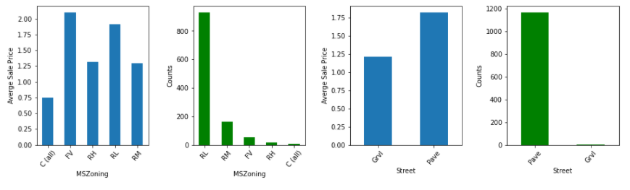
MSZoning:Floating Village Residential(FV) has highest average Sale Price of the houses and RL(Residential Low Density) types of Zoning has highest types of houses and very low amount of houses for commercial(C) types of Zoning.
Street: Paved Type of road access to property has highest average Sale Prices for the houses and Low amount of houses are there that are Gravel Type of road access to property.

Slide 32
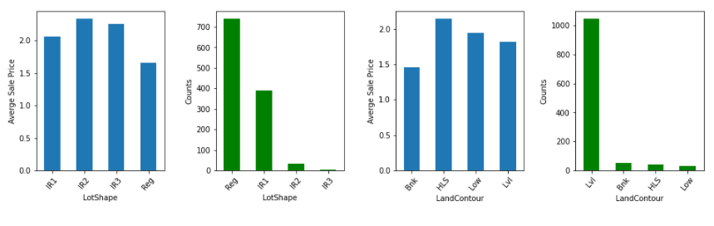
Lot Shape : Not much info we gathered from Lo Shape but Moderate type of irregularities has highest average sale Price while Irregular type of records are not much available in our dataset.
LandContour: HLS(Hillside - Significant slope from side to side) has highest Sales Price while Flat type buildings has higher o. of records in the dataset

Slide 33
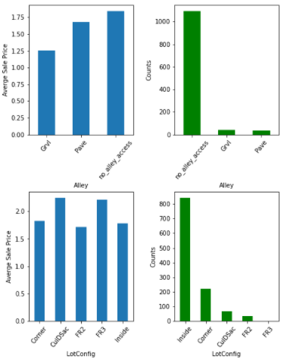
Alley: No alley access types of such houses are very common and their prices for Sale is highest.
Lot Config: Cul-de-sac & Frontage on 3 sides of property(CullDSac & Fr3) having highest Sale Prices for the houses while such type of houses are rarely available.

Slide 34
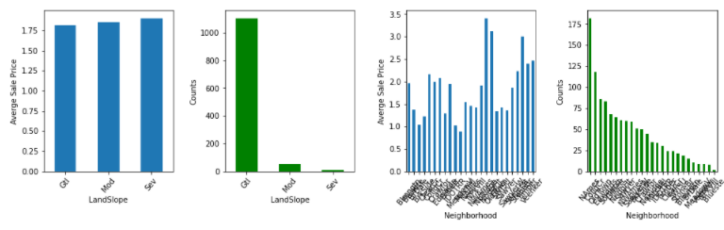
Land Slope: No such impact n the Sale Price for the houses while Gentle Slope(Gtl) has highest no. of records among them.
Neighborhood: North Ames (NAmes) such type houses are mostly available.

Slide 35
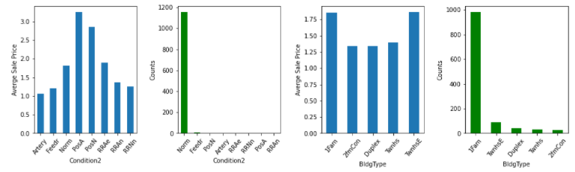
Condition2: It is Proximity to various conditions in which PosA(Adjacent to positive off-site feature) types has highest Sale Price while Norm i.e., Normal proximity to various condition such type are easily available in Sale.
Bldg Type: it is type of dwelling in the house in which Single-family Detached & Townhouse End Unit (1Farm & TwnhsE) has highest Sale Price and 2FmCon type are rarely found to Sale.

Slide 36
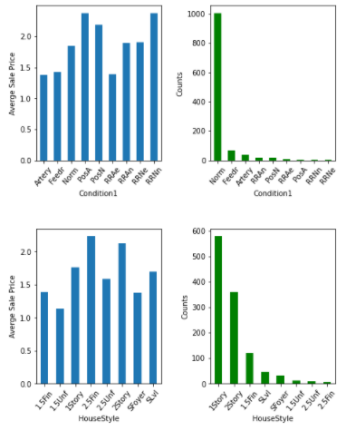
Condition1: Its shows the Proximity to various conditions in which we found that RRNn & PosA (Within 200' of North-South Railroad and Adjacent to positive off-site feature) sch type has highest average Sale Prices for the houses. While Norm(NOrmal0 type of houses are easily available for Sale.
HouseStyle: Two and one-half story: 2nd level finished(2.5 Fin) such houses are rarely available to sale and has highest prices for Sale.

Slide 37
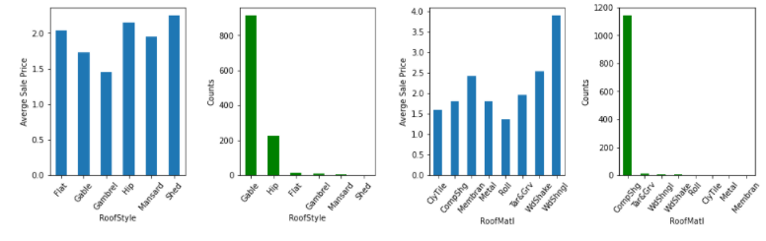
RoofStyle: Shed type of roof in the houses are very rarely available for sale and are expensive.
RoofMatl: Wood Shingles type of material used for roofs in the houses are rarely available and such houses are expensive.

Slide 38
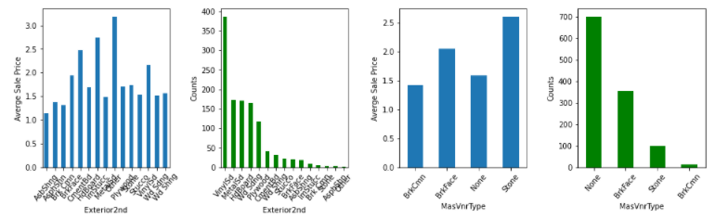
Exterior2nd: Other type Exterior covering on house are rarely available in the sale are costly such houses.
MasVnrType: Stone type Masonry veneer type of houses are expensive and Brick Common type of masonry veneer type of houses are rarely available in the Sales.

Slide 39
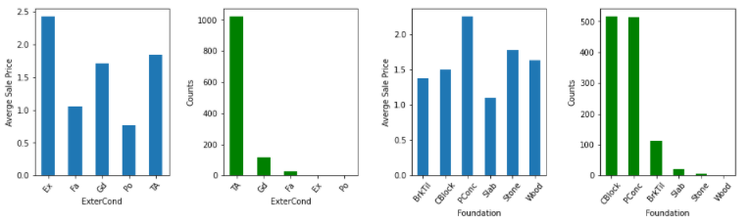
ExterCond: Evaluates the present condition of the material on the exterior in which Excellent quality of houses are rarely available and are expensive ones in the Sale.
Foundation: Poured Concrete Type of foundation are costly in Sale of houses while wood type are rarely available in Sale of Houses.

Slide 40
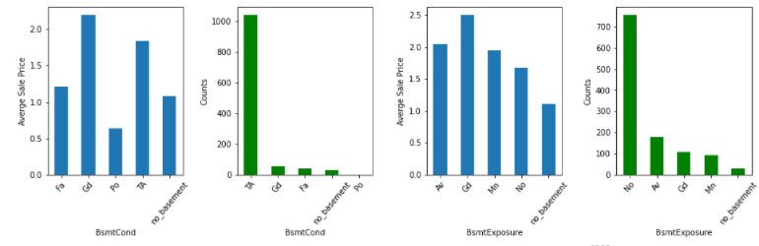
BsmtCond: The basement condition is good then such houses are expensive while Poor type of basement Condition are rare.
Basement Exposure: The exposure of the basement is better their prices for sale is better while No basement in houses are very easy easily available in the sale.

Slide 41
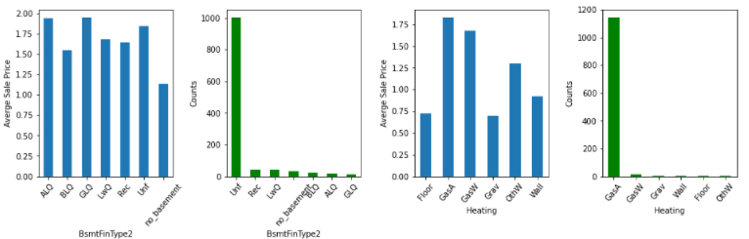
BsmtFinType2: Better the Living Quarters better the sale Prices for the houses and mostly houses have unfinished basement in it.
Heating: GasA(Gas forced warm air furnace) type of heating in the houses are mostly in the houses and such type of heating container has high sale Price.

Slide 42
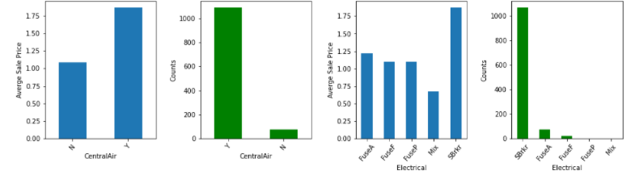
CentralAir : Mostly houses has Central Air in it and are Costly.
Electrical: Mostly houses has Electical system of SBrkr(Standard Circuit Breakers & Romex) in it and are Costly.

Slide 43
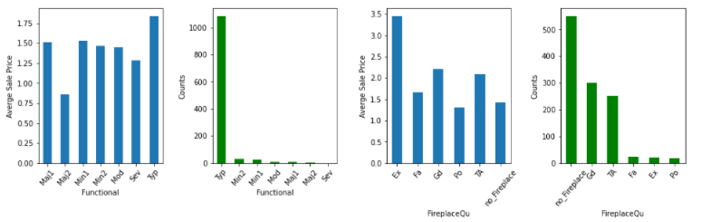
Functional: Home functionality Typ(typical) type are in most of houses and such houses have high sale Price.
FirePlaceQual: Better the quality for fire place having higher Sale Prices for such houses.

Slide 44
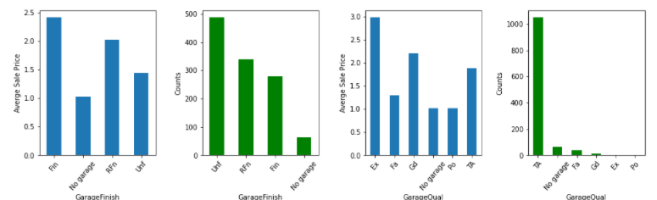
Garage finish: better the finishing of garage better the Sale Price and vary rare houses that has not Garage in it.
Garage Qual: Better the quality of garage in the houses higher the prices of houses. And mostly houses their garage quality is typical/Average.

Slide 45
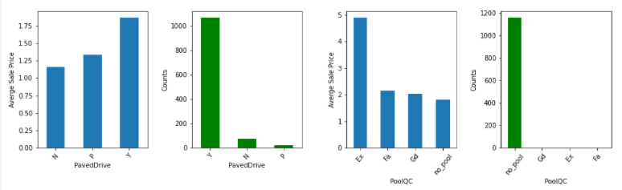
Paved drive: Paved(Y) driveway has highest average Sale Price of the houses and mostly founded during Sale of houses.
PoolQC: Better the quality and conditions for the pool of the houses better the Sale Price of the houses. Most of houses hasn't have pool in it.

Slide 46
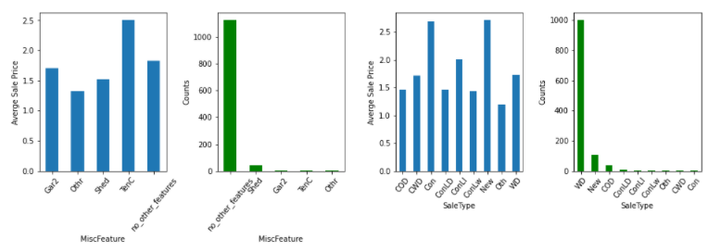
MiscFeature: Miscellaneous feature not covered in other categories in which houses Tennis Court is available such houses has higher Sale Price. Mostly houses has has no other miscellaneous features in it.
SaleType: con(Contract 15% Down payment regular terms) and New(Home just constructed and sold) such types of sales has highest Sale Prices. mostly houses are those whose Sale type WD (Warranty Deed - Conventional).

Slide 47
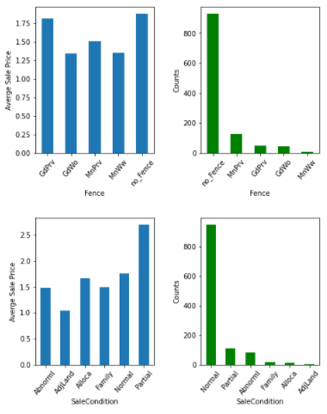
Fence: Fence is not impacting much to Sale Price for the houses but mostly houses doesn't have fencing in it.
Sale Condition: Partial [Home was not completed when last assessed (associated with New Homes)] such condition of Sales are having High Sale prices for the houses. While most of houses has normal Sale Condition.

Slide 48
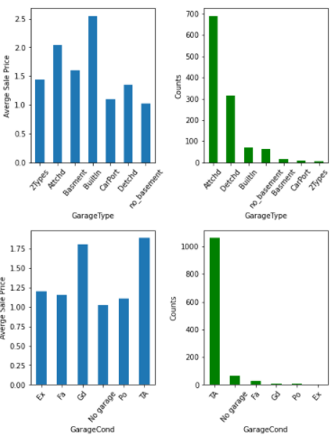
GarageType: Built-in Garage types of houses are expensive in Sale Price and 2Types are rarely available for sale.
GarageCond: Good and Typical/Average type of garage condition in the houses has higher Sale Price of the houses.

Slide 49
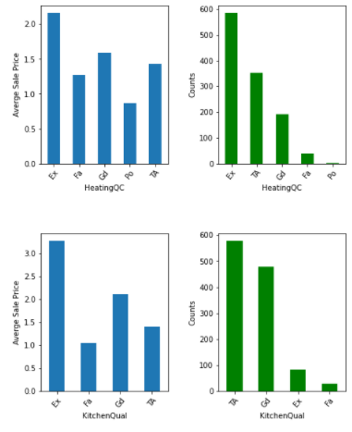
HeatingQC: Better the heating Quality and its conditions better the Sale Price for the houses.
KitchenQual: Better the quality of kitchen of the houses better their Sale Price.

Slide 50
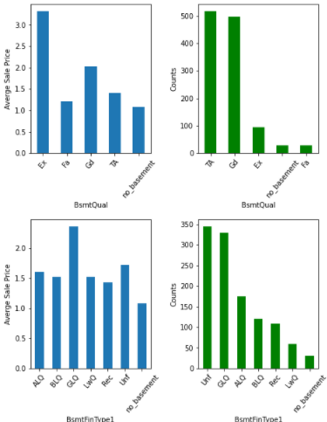
BsmtQual: Excellent Quality of basement in the houses are expensive while fair type of basement quality are rarely available in the sale of houses.
BsmtFinType1: Better the Living Quarters better the sale Prices for the houses and there are very less houses that doesn't have basement in it.

Slide 51
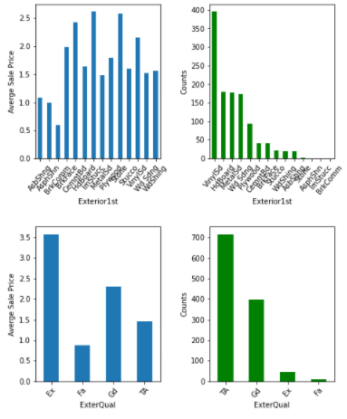
Exterior1st: Exterior covering on house in that Imitation Stucco of exterior used in the houses are rarely available and such houses are costly.
ExterQual: Evaluates the quality of the material on the exterior in which Excellent quality of houses are rarely available and are expensive ones in the Sale.

Slide 52
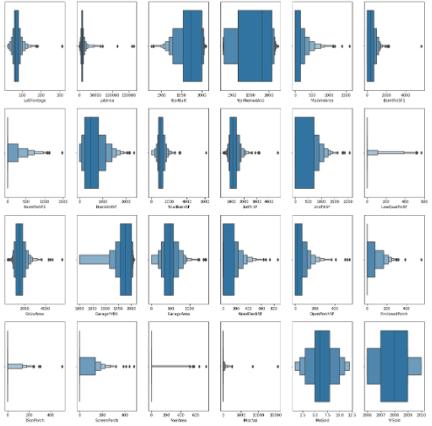
Outliers Detection
Trained Dataset:
LotArea, BsmtFinSF1, BsmtFinSF2, TotalBsmtSF, 1stFlrSF, GrLivArea, EnclosedPorch, 3SsnPorch, MiscVal.
These features consisting outliers in it.

Slide 53
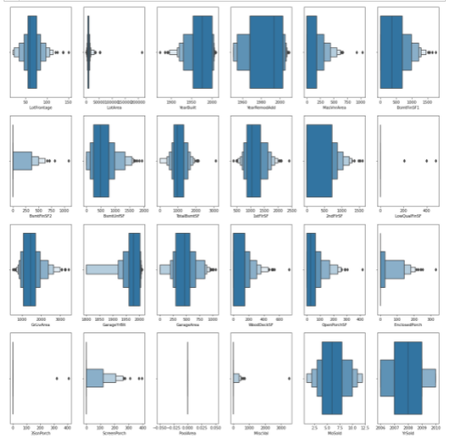
Test Dataset:
LotArea, BsmtFinSF2, TotalBsmtSF, 1stFlrSF, EnclosedPorch, 3SsnPorch, MiscVal.
These features consisting outliers in it.

Slide 54
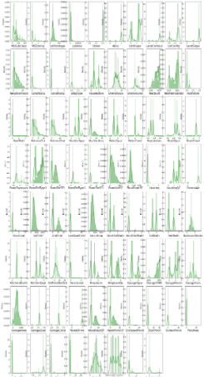

Distribution
Trained dataset
Test Dataset

Slide 55

Multi- Colinearity
Exterior1st & Exterior2nd ---> 80% collinear to each other.
GrLivArea & TotRmsAbvGrd are 82% collinear to each other.
TotalBsmtSF&1stFlrSF--->81% collinear with each other.
BsmtFinSF2&BsmtFinType2 ----> -81% collinear.
BsmtFinSF1&BsmtFinType1 ----> -73% collinear.
GarageCars & GarageArea ----> 88% collinear to each other.
FirePlace&FireQual are 72% collinear to each other.
MiscFeature & MiscVal are 78% collinear to each other.
PoolArea & PoolQC are collinear about -93%.

Slide 56

Relation of features with the Label

Slide 57
Data Cleaning

Slide 58
Steps taken cleaning data:
Removed duplicates records.
Removed features that has very less impact to predict the sale prices for the houses
Reduce variance using Square root to the features that has high variance.
Reduce outliers using Z- score technique.
Reduce skewness for the features.
Drop more columns so that model does not overfitted that has high variance after reducing skewness, outliers.

Slide 59
Data loss
Data Loss for training dataset after Cleaning:8.73%.
Data Loss for test dataset after Cleaning:8.56%

Slide 60
Model Deployment

Slide 61
Algorithms Used:
Used 8 models that are:
Linear Regression
Decision Tree
Random Forest
Gradient Boosting
AdaBoost
Bagging
Support Vector Machine
Xtreme Gradient Boost

Slide 62
Steps taken :
Split the trained dataset into X, Y i.e. features and label.
Used PCA for Features Selection
Use Standard Scalar for normalization
We used every 8 model to find best accuracy for each model with the best random state for it.
Best cv score for the each model.
Least difference between best accuracy and cv Score for each model for the finalized model.
With respect to finalized model with divided training, test features and label with it best random state and plotted regplot.
Ang we do hyper tuned the finalized model.

Slide 63

Feature Selection:
We selected 20 feature Using Principal Component Analysis that we can see the knee- graph for both the trained as well as test dataset.

Slide 64


Accuracy and model evaluation for each model

Slide 65


Slide 66

Model Selection
Here for model Random Forest Regressor we get the least value i.e. the difference between the accuracy and cv Score of this model is 3.64.

Slide 67

Regression plot with Random Forest model
Here we analyze that the data points are close to the best fit line. That means the residual is less.

Slide 68

Regularization
Here we can see that our model is not overfitted or underfitted as the r2 score Lasso model is 79.44 while the Random Forest r2-score is 86.9

Slide 69

Hyper tunning
AS after doing hyper tuned the Random forest regressor model we decreased the accuracy of the model.

Slide 70

There is very slight decrease in the errors after hyper tuned the model.
So, using Random Forest default parameterized model to predict Sales prices for the houses.

Slide 71
Thank You!!

